Slide 1
Top Ten Diagnoses You Can Make With an Ultrasound!

Slide 2
ABDOMINAL aortic aneurysm
Number 1

Slide 3
Why it Matters
A medical emergency with a high mortality rate (80% when ruptured!)
Easily diagnosed with bedside ultrasound…
…but, difficult to diagnose by clinical history alone
“classic” symptoms are actually quite infrequent

Slide 4
Making the Call
Examine the entire aorta with the 3.5 MHz curvilinear transducer down to the iliacs
Visualize the aorta above and below the renal arteries and measure (should be < 3 cm)
Measure the iliacs on both sides, below the aortic bifurcation (should be < 1.5 cm)
Measurement should be in the transverse plain

Slide 5
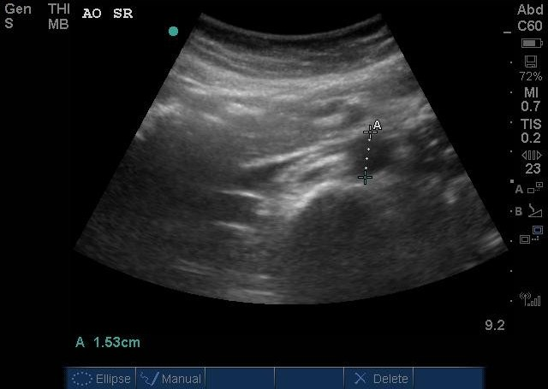
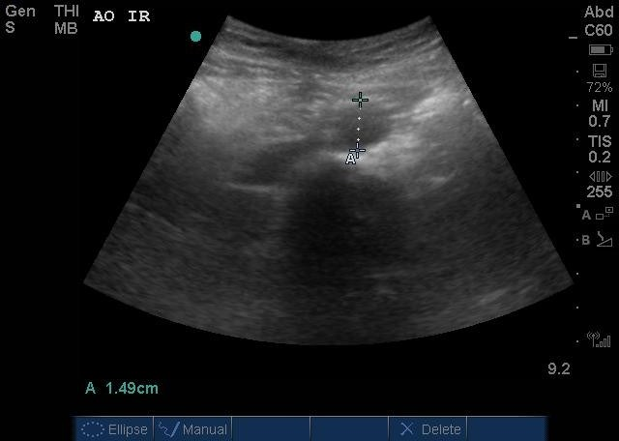
Normal
Suprarenal aorta
Infrarenal aorta
Both should measure about the same!

Slide 6
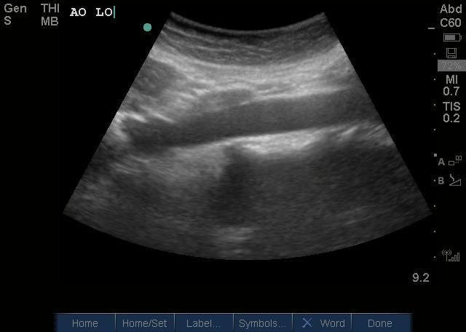
Normal
Clean, no out-pouchings!

Slide 7
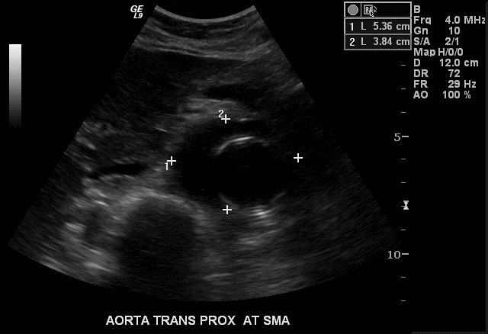
Abnormal
Aneurysm!

Slide 8
Ectopic pregnancy
Number 2

Slide 9
Why it Matters
A life-threatening complication of pregnancy
High morbidity and mortality rate when undiagnosed and ruptured
Occurs in roughly 2% of all pregnancies
Abdominal pain and bleeding are common ED complaints in pregnant patients – this is the diagnosis you don’t want to miss!

Slide 10
Making the Call
Absence of gestational sac in the uterus
A complex mass in the adnexa or fallopian tube
Free fluid in the Pouch of Douglas, or even in Morrison’s Pouch!
Many women with ectopics have no visible adnexal mass of free fluid

Slide 11
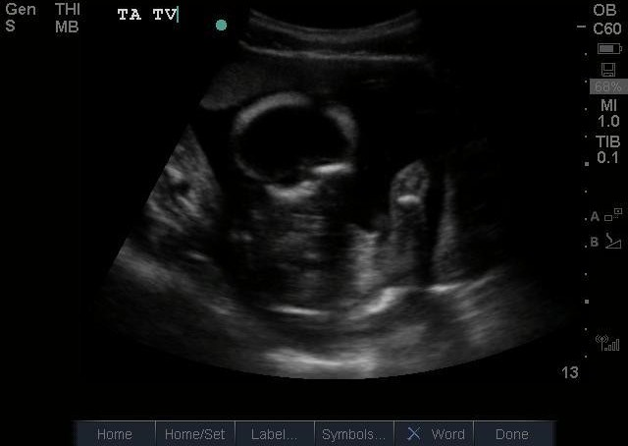
Normal
Intrauterine pregnancy!

Slide 12
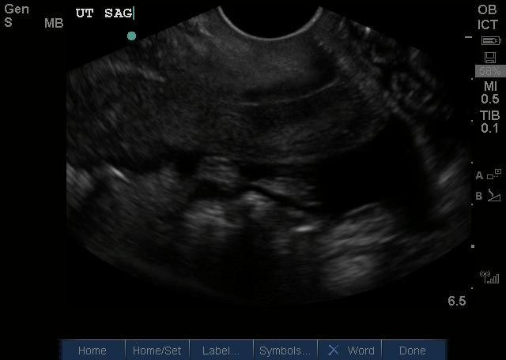
Abnormal
Black is
Free fluid!
Empty uterus!

Slide 13
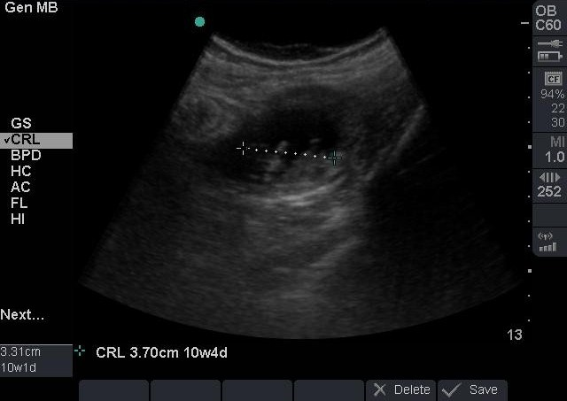
Abnormal
Complex mass in the adnexa!

Slide 14
Retinal detachment
Number 3

Slide 15
Why it Matters
Patients may have initially localized detachment…
Without rapid treatment, the condition quickly develops in to permanent vision loss/blindness

Slide 16
Making the Call
Choose the linear vascular probe and put gel and tegaderm over it
You normally shouldn’t see the retina
When detached, you see two hyperechoic lines with anechoic fluid in between on the posterior aspect of the eye

Slide 17
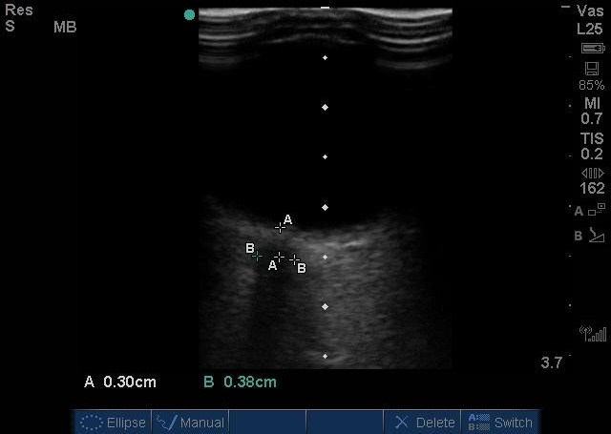
Normal

Slide 18
Abnormal

Slide 19
Increased intracranial pressure
Number 4

Slide 20
Why it Matters
“Monro-Kellie Hypothesis”: volume inside the skull is fixed
In other words, if you increase the volume of one thing in the brain, you have to decrease the volume of something else
Extremely high pressures can lead to brain herniation and death
An dilated optic nerve is a sign of increased intracranial pressure

Slide 21
Making the Call
Place the same linear probe over the eye and find the optic nerve
Draw two lines perpendicular to one another:
  Line 1 goes from the back of the eye exactly 3mm posterior down the optic nerve
  Line 2 then cuts perpendicularly at the base of Line 1 from one end of the optic nerve to the other
Line 2 should be less than 4.5, otherwise there should be concern for increased ICP

Slide 22
Normal
A – measure 0.3 cm from the back of the eye
B – measure the optic nerve where it intersects the “A” line

Slide 23
Abnormal
The optic nerve is dilated signifying increased ICP!

Slide 24
Urinary retention
Number 5

Slide 25
Why it Matters
OK, OK, maybe not typically a life-threat
… but, certainly uncomfortable for the patient
And, electrolyte disturbances resulting from post-void diuresis can be significant
Ultrasound can quickly help you decide if the patient needs a foley catheter and bladder decompression

Slide 26
Making the Call
Volume estimations of a cylinder
Your specific ultrasound machine should have a formula built in
Three measurements:
  D1
  D2
  D3

Slide 27
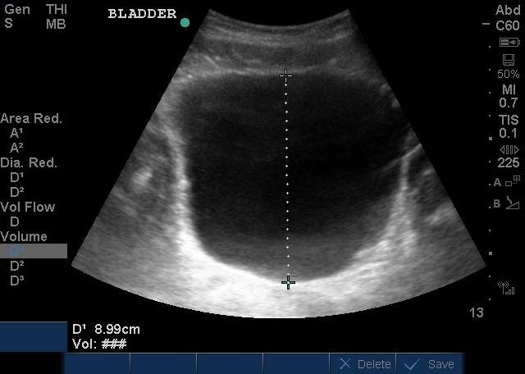
Calculating…
First measurement, then click “save calc”

Slide 28
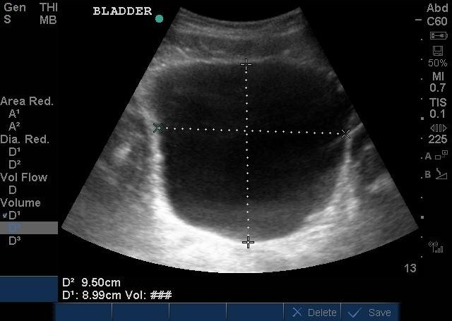
Calculating…
Second measurement, “save calc” again

Slide 29
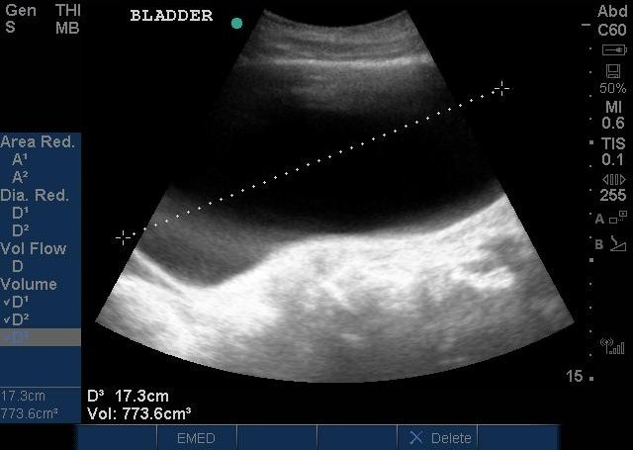
Calculating…
Rotate your probe 90-degrees, then measure once more, click “save calc”
and your volume appears at the bottom!

Slide 30
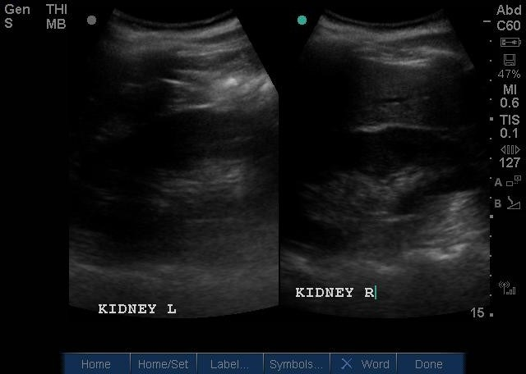
Check for hydro!
Normal kidneys…

Slide 31
GALLBLADDER DISEASE
Number 6

Slide 32
Why it Matters
A quick and easy diagnostic tool that does not require radiation!
Significant complications when missed or misdiagnosed:
  Perforation
  Ascending cholangitis → sepsis → death

Slide 33
Making the Call
Three views: a view in long axis, transverse axis, and left lateral decubitus (to see if the stone moves!)
Look for the common bile duct to see if it is dilated
Signs of cholecystitis:
  Gallbladder wall that is bigger than .5 cm
  Fluid around the gallbladder

Slide 34
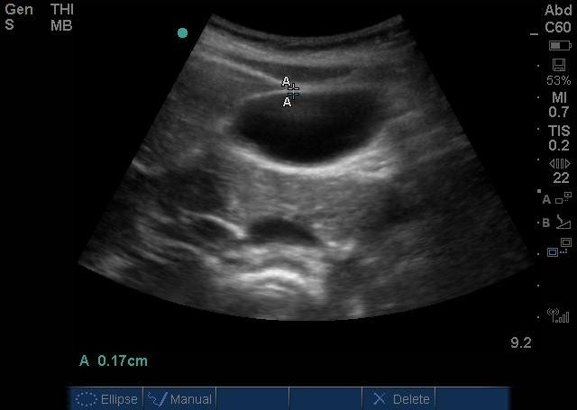
Normal

Slide 35
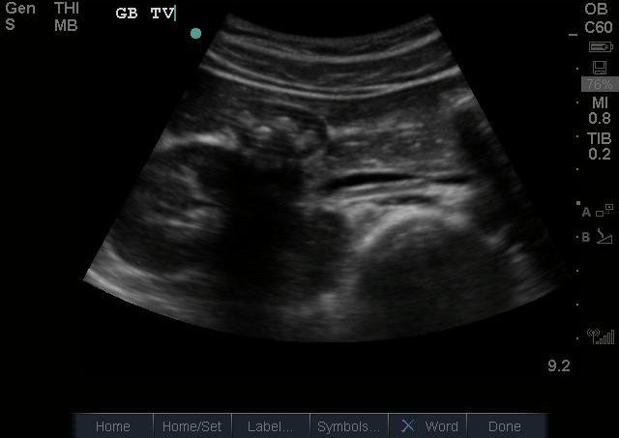
Abnormal
Stones in
the GB
Stones
shadowing!

Slide 36
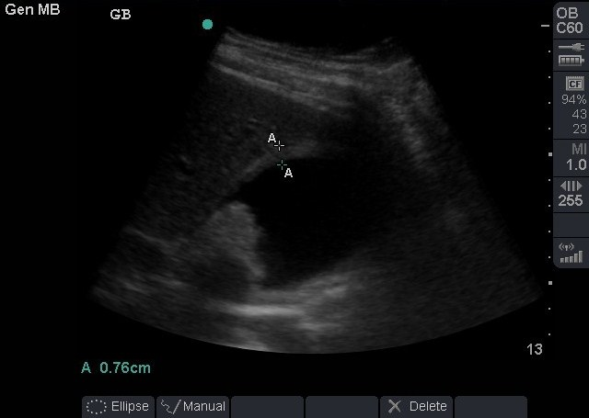
Abnormal
Thick gallbladder wall, measured here at 0.76cm!

Slide 37
Pleural effusion
Number 7

Slide 38
Why it Matters
A treatable cause of shortness of breath frequently encountered in the ED
Often visible on chest x-ray, but difficult to quantify
US can also aid in finding the best location for thoracocentesis or chest tube placement

Slide 39
Making the Call
Use the linea vascular probe and place it in three locations – anterior, posterior, and axillary
Look for hypoechoic (black) dead space between the granular appearing lung and the bright, hyperechoic pleura

Slide 40
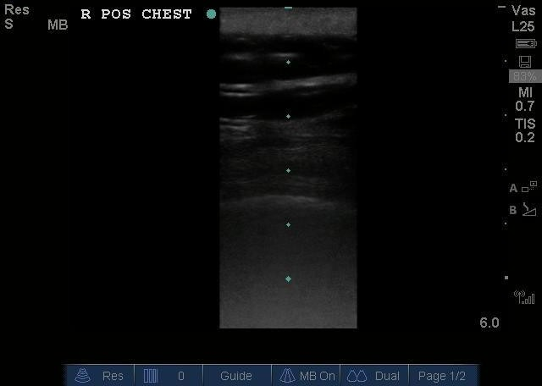
Normal
Soft
tissue
Pleural
lining
Normal
lung

Slide 41
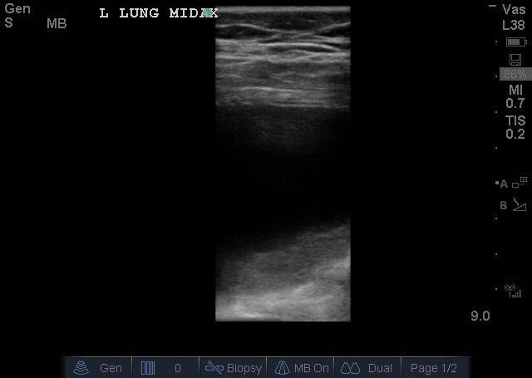
Abnormal
Pleural
effusion
Compressed
lung

Slide 42
Pericardial effusion
Number 8

Slide 43
Why it Matters
A cause of cardiovascular collapse that requires emergent treatment
US can quickly diagnose the problem and guide safe treatment (pericardiocentesis)

Slide 44
Making the Call
Best seen on subxiphoid view with the cardiac probe as an anechoic (black) area surrounding the echogenic (bright) heart
Ideally you see a four-chamber view to assess for ventricular collapse

Slide 45
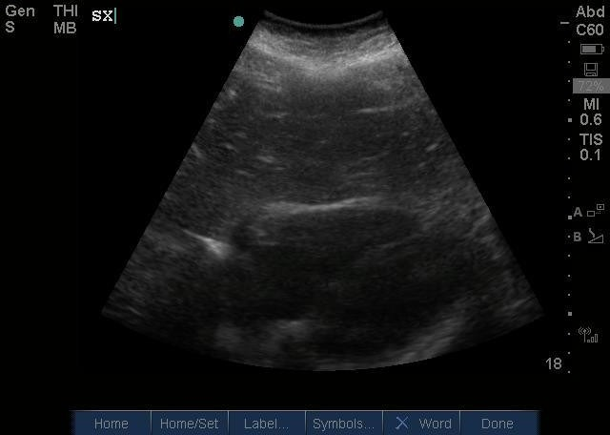
Normal

Slide 46
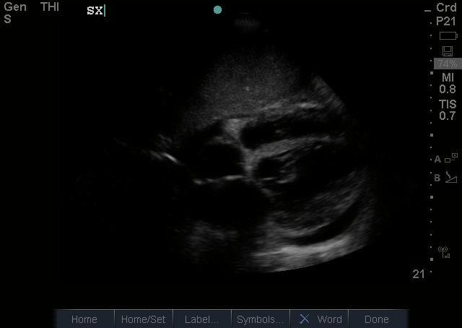
Abnormal
Pericardial effusion

Slide 47
Free fluid in the abdomen
Number 9

Slide 48
Why it Matters
In the case of a trauma patient, generally means the patient is bleeding
A surgical emergency, and an indication for an exploratory laparotomy
Much less invasive that other tests for free fluid (DPL)

Slide 49
Making the Call
The FAST Exam, a focused assessment with sonography in trauma, which literally should be a fast exam!
  Four views in the abdomen: Morrison’s pouch, the splenorenal gutter, subxiphoid space, suprapubic space
If you see fluid, there is at least 250 mL in the abdomen

Slide 50
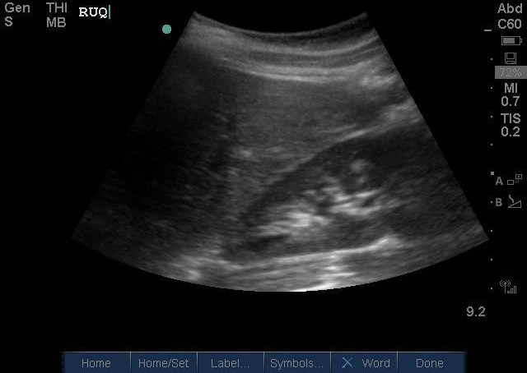
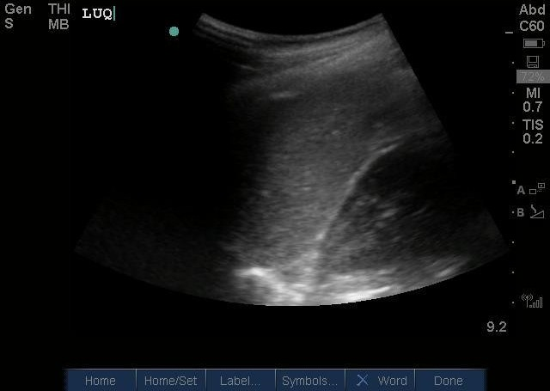
Normal
Morrison’s Pouch
Splenorenal Recess

Slide 51
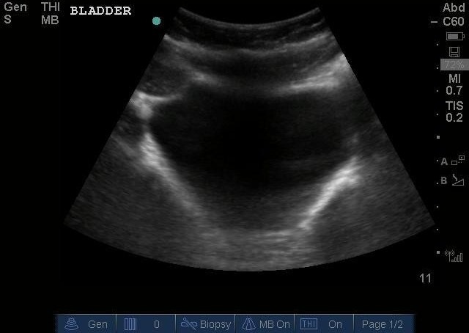
Normal
Heart
Bladder

Slide 52
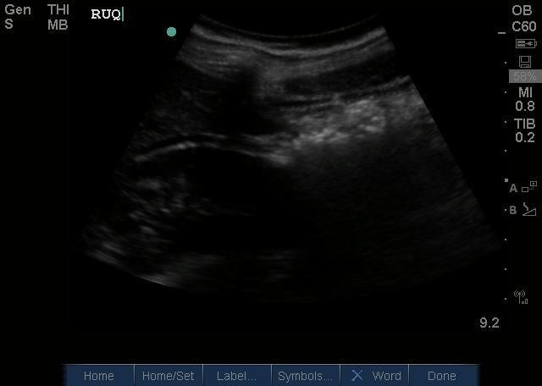
Abnormal
Free fluid!

Slide 53
DVT
Number 10

Slide 54
Why it Matters
A common disorder in critically-ill patients
When untreated can go on to cause pulmonary embolism, which is potentially deadly

Slide 55
Making the Call
Using the linear probe, take four image clips:
  Three of the clips should be of you compressing the deep veins of the thigh at different locations (common femoral vein, superficial femoral vein, popliteal vein); the veins should completely collapse
  One clip should be in doppler mode while looking at any of these three veins, with a 2nd operator squeezing the calf to prove “augmentation”

Slide 56
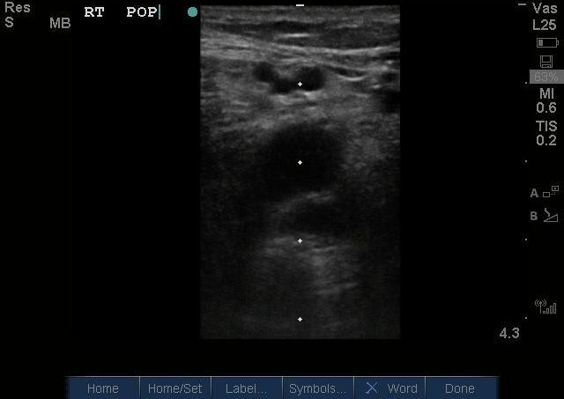
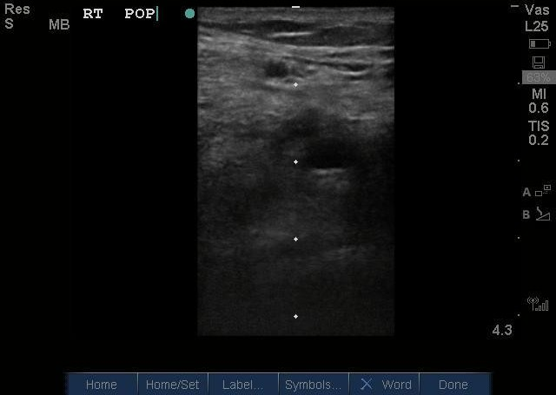
Normal
Popliteal vein
With compression… vein disappears!

Slide 57
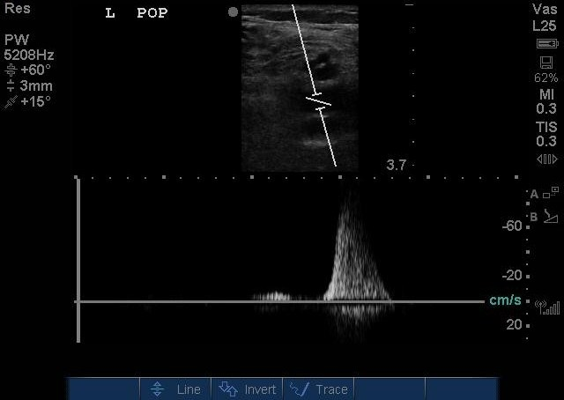
Normal Augmentation
Doppler the femoral vein while simultaneously squeezing the calf!
The spike is normal – means blood flow gets back up from the calf to the thigh!

Slide 58
Abnormal

